Slide 1


NATURAL LANGUAGE TO SQL QUERY GENERATION USING GEN AI
K.RAMAKRISHNAN COLLEGE OF TECHNOLOGY
(AUTONOMOUS),TRICHY
BATCH-11 PRESENTING
AJANEESHWAR S (811721243005)
KAMALESHWAR A (811721243023)
NAVEEN KUMAR K R (811721243038)
SIDDHARTHAN R (811721243052)
GUIDED BY : JOANY FRANKLIN M.E,..

Slide 2
OBJECTIVE
To develop an AI-powered system that converts natural language queries into SQL queries, enabling users to interact with databases without SQL expertise
Notes:
. It leverages Generative AI to interpret user intent, generate accurate queries, and optimize database interactions.

Slide 3
ABSTRACT
Project aims to develop an AI-powered system that allows users to access databases effortlessly without any SQL knowledge. Using Generative AI, it translates natural language queries into optimized SQL commands. The system ensures accuracy, supports multiple databases, and includes error handling, making data retrieval intuitive, efficient, and user-friendly for both technical and non-technical users.

Slide 4
EXISTING SYSTEM
In traditional database management, users must manually write SQL queries to retrieve, update, or manipulate data.
Some existing solutions, like SQL query builders and dashboard tools (e.g., Power BI, Tableau, MySQL Workbench), offer graphical interfaces, but they still require SQL knowledge for complex queries.
These limitations create a gap that AI-powered Natural Language to SQL systems aim to fill by making database access intuitive and accessible to all users.
Notes:
Additionally, rule-based NLP-to-SQL systems exist, but they lack the flexibility to understand varied natural language inputs accurately.
This requires a strong understanding of SQL syntax, database structures, and query optimization techniques.

Slide 5
PROPOSED SYSTEM
Natural Language to SQL Conversion – Uses LLMs (Gemini) to generate SQL queries.
Schema-Aware Mapping – Automatically identifies relevant tables and columns for accurate query formation.
Query Validation & Optimization – Ensures error-free, efficient, and optimized SQL execution.
Multi-Database Support – Works with MySQL, PostgreSQL, SQLlite, and other relational databases.
User-Friendly Interface – Enables non-technical users to retrieve and analyze data easily. At last it can be downloaded as CSV file.
Notes:
Additionally, rule-based NLP-to-SQL systems exist, but they lack the flexibility to understand varied natural language inputs accurately.
This requires a strong understanding of SQL syntax, database structures, and query optimization techniques.

Slide 6
LITERATURE SURVEY
S No | Paper Title | Author Name | Year of Publish | Techniques used | Merits
1. | RePrompt: Automatic Prompt Editing to Refine AI-Generative Art Towards Precise Expressions | Yunlong Wang, Shuyuan Shen, Brian Y. Lim | 2023 | Text-to-image generated model, prompt engineering, AI-generated visual art, emotion expression, explainable AI | High accuracy, robust, Higher efficiency
2. | Based on natural language processing, human-computer dialogue, image recognition, and machine learning analysis whether artificial intelligence will surpass the human brain | Chunxu MU | 2023 | Artificial intelligence, speech recognition, natural language processing | Better technique, Precised accuracy
Demerits
Accuracy is prompt drift, processing overhead
Shallow insight,complex system

Slide 7
LITERATURE SURVEY
S No | Paper Title | Author Name | Year of Publish | Techniques used | Merits
3. | Prompt Evolution for Generative AI: A Classifier-Guided Approach | Melvin Wong, Yew-Soon Ong, Abhishek Gupta, Kavitesh Kumar Bali, Caishun Chen | 2023 | Prompt evolution, generative model, user preference, single-objective, multi-X evolutionary computation | Multiple analysis, High accuracy, robust, Higher classification rate
4. | Large Language Models are not Models of Natural Language: they are Corpus Models | Csaba Veres | 2022 | Natural language processing, deeplearning, syntax,linguistics, language model | Higher detection rate, Robust
Demerits
Classifier errors, integeration difficulty
Meaning loss, misinterpretation risk

Slide 8
LITERATURE SURVEY
S No | Paper Title | Author Name | Year of Publish | Techniques used | Merits
5. | Progress in Neural NLP: Modeling, Learning, and Reasoning | Ming Zhou, Nan Duan, Shujie Liu, Heung-Yeung Shum | 2021 | Natural language processing Deep learning Modeling, learning, and reasoning | Easy training methodology and implementation
4. | Large Language Models are not Models of Natural Language: they are Corpus Models | Csaba Veres | 2022 | Natural language processing, deeplearning, syntax,linguistics, language model | Higher detection rate, Robust
Demerits
Resaoning flaws, model opacity

Slide 9
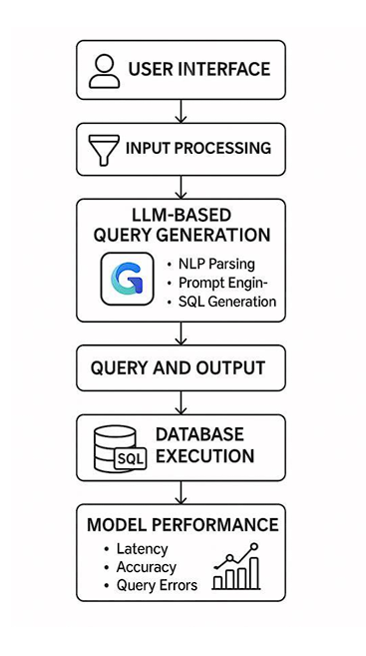
DATA FLOW DIAGRAM
Notes:
Additionally, rule-based NLP-to-SQL systems exist, but they lack the flexibility to understand varied natural language inputs accurately.
This requires a strong understanding of SQL syntax, database structures, and query optimization techniques.

Slide 10
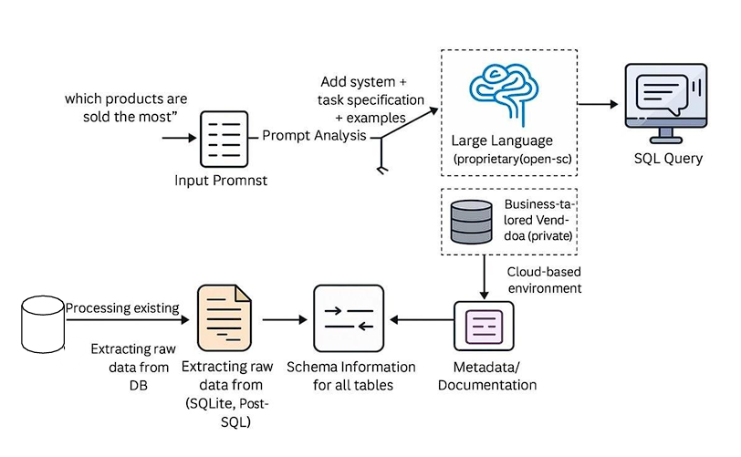
SYSTEM ARCHITECTURE
Notes:
Additionally, rule-based NLP-to-SQL systems exist, but they lack the flexibility to understand varied natural language inputs accurately.
This requires a strong understanding of SQL syntax, database structures, and query optimization techniques.

Slide 11
SYSTEM & SOFTWARE SPECIFICATIONS
HARDWARE
Processor: Dual core processor RAM: 4GB
Hard disk: 256 GB
Graphics: GTX1650
Monitor: 15-inch colour monitor
SOFTWARE
Operating system: Any
IDLE: Python 3
Web Application: VS code
Browser: Any

Slide 12
MODULE 1: USER INTERFACE
Provides a web-based UI, chatbot, or API for users to input natural language queries.
Supports text-based and here user will upload their respective database.
SQLlite, PostgreSQL are the formats supported.

Slide 13
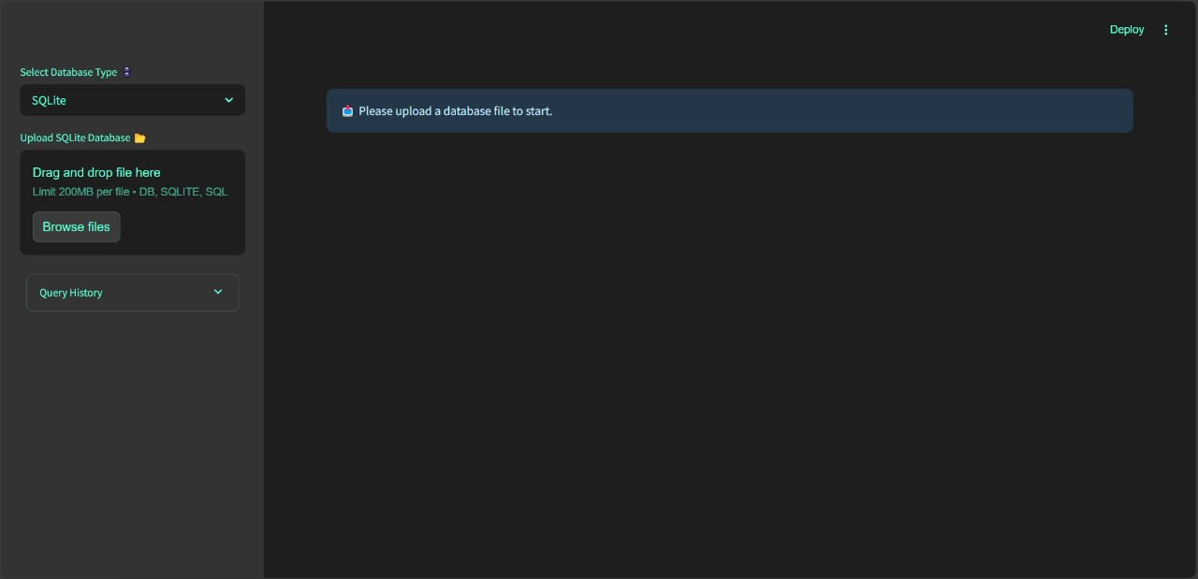
MODULE 1: USER INTERFACE

Slide 14
MODULE 2: INPUT PROCESSING
It supports queries for both SQLite and PostgreSQL formats and handles tasks like tokenization, removal of stop words, and identifying relevant entities such as column names, table names, and conditions.
Acts as a bridge between user input and the model, ensuring that queries are semantically meaningful.
It plays a critical role in maintaining the quality of the final SQL output.

Slide 15
MODULE 3: LLM BASED QUERY GENERATION
Google’s Gemini language model to translate user inputs into valid SQL queries.
This module interprets the user's intent and maps it to appropriate database elements such as tables, columns, and conditions.
It supports both SQLite and PostgreSQL syntax, adjusting its output accordingly. The model is capable of multi-turn interactions, enabling follow-up queries based on previous responses.

Slide 16
MODULE 4: QUERY AND THE OUTPUT
Executing the generated SQL queries and presenting results.
It ensures secure and efficient execution, avoiding syntax errors or invalid queries.
The output is displayed in a readable table format, making it easy for users to interpret results. In addition to viewing the output.
Users can download the data as a CSV file for further use.

Slide 17
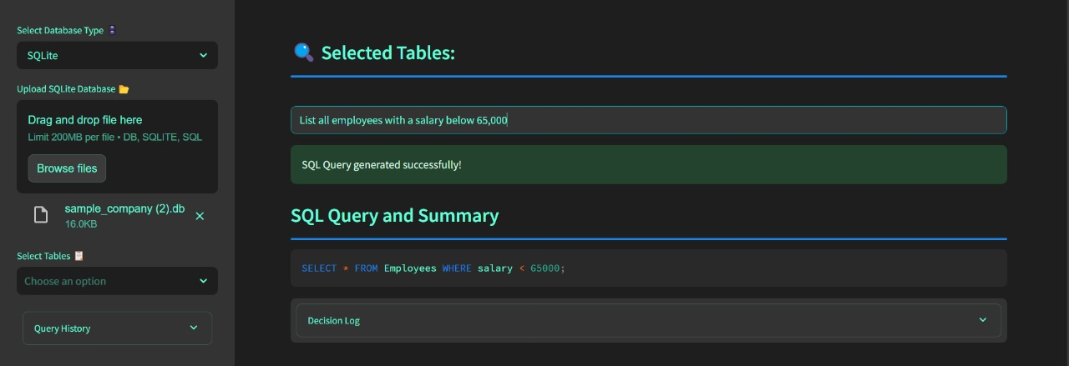
MODULE 4: QUERY AND THE OUTPUT

Slide 18
MODULE 5: MODEL PERFORMANCE AND THE OUTPUT
Provides insights into how efficiently the system operates.
It tracks and displays key performance metrics like query generation time, execution time, and overall response latency.
Prevents SQL injection attacks and ensures security compliance.

Slide 19
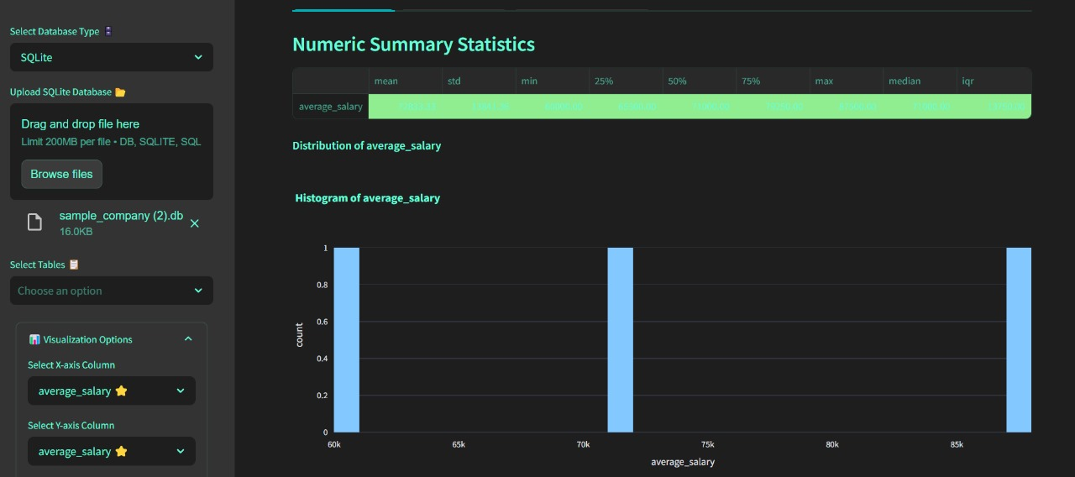
MODULE 5: MODEL PERFORMANCE AND THE OUTPUT

Slide 20
ADVANTAGES
User friendly
Automated and accurate
Fast and efficient
Secure and reliable
Scalable and adaptive
Final result can be downloaded as csv file.

Slide 21
APPLICATIONS
Business Intelligence
Customer support chatbots
Healthcare and data retrieval
Finance and banking
Retail and E-Commerce

Slide 22
CONCLUSION
Generative AI (LLMs) bridges the gap between non-technical users and SQL.
Text-to-SQL models enable efficient and intuitive database querying.
This solution improves business intelligence, accessibility, and decision-making.
Notes:
Additionally, rule-based NLP-to-SQL systems exist, but they lack the flexibility to understand varied natural language inputs accurately.
This requires a strong understanding of SQL syntax, database structures, and query optimization techniques.

Slide 23
REFERENCES
Chunxu MU,(2023),“Based on natural language processing, human-computer dialogue, image recognition, and machine learning analysis whether artificial intelligence will surpass the human brain”.
Csaba Veres,(2022),“Large Language Models are not Models of Natural Language: they are Corpus Models”.
Melvin Wong, Yew-Soon Ong, Abhishek Gupta, Kavitesh Kumar Bali, Caishun Chen,(2023), “Prompt Evolution for Generative AI: A Classifier-Guided Approach”.
Ming Zhou, Nan Duan, Shujie Liu, Heung-Yeung Shum,(2021), “Progress in Neural NLP: Modeling, Learning, and Reasoning”.
Yunlong Wang, Shuyuan Shen, Brian Y. Lim,(2023), “RePrompt: Automatic Prompt Editing to Refine AI-Generative Art Towards Precise Expressions”.
Notes:
Additionally, rule-based NLP-to-SQL systems exist, but they lack the flexibility to understand varied natural language inputs accurately.
This requires a strong understanding of SQL syntax, database structures, and query optimization techniques.

Slide 24
THANKYOU…..
Notes:
Additionally, rule-based NLP-to-SQL systems exist, but they lack the flexibility to understand varied natural language inputs accurately.
This requires a strong understanding of SQL syntax, database structures, and query optimization techniques.

